Slide 1
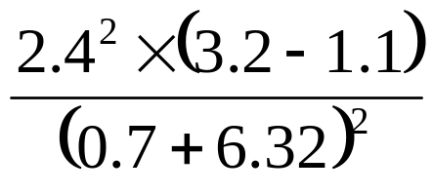
Calculator Methods
WALT:
WILF:
Use calculators to carry out more complex calculations
Level 5
Is for you to:
Is for you to:
Is for you to:
Put brackets into this calculation to make it correct.
2.4 x 4.3 + 3.7 = 19.2
Use your calculator to work out this.
Answer worded questions.
Level 5
Level 6
Level 6
Appropriate degree of accuracy Brackets
Order of operations
Keywords

Slide 2

Calculator Methods
Starter:
Answer these questions using a calculator and then turn the calculator upside down and write out the word.
1
Subtract 68 from 119
2
Multiply 926 by 4
3
Add 0.4 and 0.2
4
Divide 6,090 by 2
is
Hole
go
shoe
5
Divide 27,685 by 5
6
Add 0.2949 and 0.4785
7
Subtract 2,555 from 37,891
8
Multiply 2,688,308 by 2
less
hello
geese
giggles

Slide 3
Calculator Methods
Rounding Answers:
Use your calculator to find the answer to: 48 ÷ 9
What did you get?
Round this to 2 decimal places.
Use your calculator to find the answer to: 25 ÷ 6
What did you get?
Round this to 2 decimal places.
5.33333333
5.33
4.16666667
4.17

Slide 4


Exercise 1:
Use your calculators to work the following questions and round to 2 decimal places.
1
40 ÷ 3
2
16 ÷ 11
3
14 ÷ 6
4
25 ÷ 9
5
19 ÷ 13
13.33
1.45
2.33
2.78
1.46
6
5 ÷ 6
7
1 ÷ 3
8
4 ÷ 9
9
20 ÷ 11
10
29 ÷ 6
0.83
0.33
0.44
1.82
4.83
11
35 ÷ 9
12
54 ÷ 7
13
35 ÷ 13
14
56 ÷ 17
15
80 ÷ 7
3.89
7.71
2.69
3.29
11.43
Clarke wants to share £80 between his 3 friends. How much money will each friend get?
£1.07
Bags of sugar come in three different sized packets. Work out which bag is the best value for money.
Large: 2.2kg for £2.36
Medium: 1kg for £1.15
Small: 0.6kg for £0.70
Large:
£1.07 per kg
Medium:
£1.15 per kg
Small:
£1.17 per kg

Slide 5
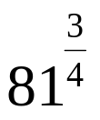














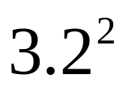

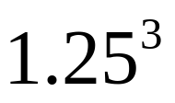
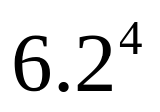
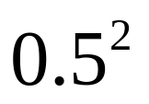


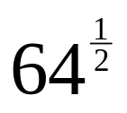
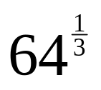
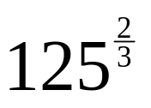
Calculator Methods
Using calculators – Example Set 1:
Work out :
KEY IN:
NOW PRESS EQUALS:
Exercise 2:
5
.
9
x^{y}
4
8
1
x^{y}
(
3
÷
4
)
1211.7361
27
Use your calculators to work the following questions and round to 2 decimal places if necessary.
1
2
3
4
5
10.24
59049
1.95
1477.63
0.25
6
7
8
9
10
2
3
8
4
25

Slide 6





















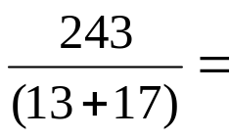











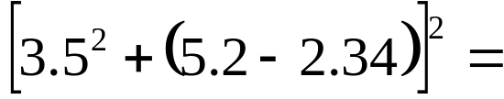


















Calculator Methods
Using calculators:
(12 + 18) x 31 =
186 ÷ (67 – 59) =
(
1
2
+
1
8
)
x
3
1
930
1
8
6
÷
(
6
7
-
5
9
)
23.25
2
4
3
÷
(
1
3
+
1
7
)
8.1
(
3
.
5
x²
+
(
5
.
2
-
2
.
3
4
)
)
x²
228.312

Slide 7
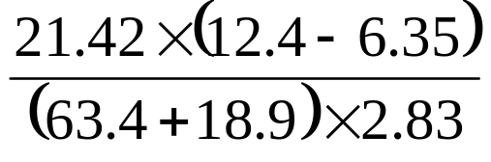
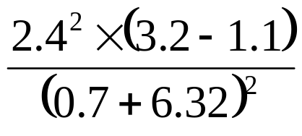
Calculator Methods
Example Set Two:
Use a calculator to work out the value of:
We need to put brackets around the top and bottom.
(21.42x(12.4-6.35))÷((63.4+18.9)x2.83)
=0.556401856
Use a calculator to work out the value of:
We need to put brackets around the top and bottom.
(2.4²x(3.2-1.1))÷((0.7+6.32)²)
=0.245452553

Slide 8
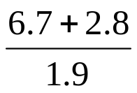
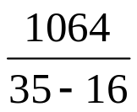
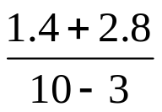
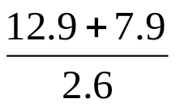

Exercise 3:
Use your calculator to work out the following
a
7 + 3 x 6
b
13 x 2 + 8 x 3
c
100 ÷ 4 x 2
d
6.8 x 7 + 18.1
25
50
50
65.7
e
18 ÷ (2x3)
f
(17+26) x 43
g
(5x2) - (6÷2)
h
(10–5)+(6.2x5)
3
1849
7
36
i
j
k
l
5
56
0.6
8
Sean lives in Crosby and works in Liverpool City Centre. His journey to work is 6.6 miles. Decide if it is better to travel to work by car or by train.
By Car |  | By Train
Insurance | = £310.49 | Monthly Ticket | £89.00
Tax | = £115.00
Servicing | = £99.00
Petrol | = £1.04 /Litre
Consumption | = 8 miles/Litre
Car Park | = £60 /month
By car:
Cost of petrol: £446.16
Car Park: £720.00
Total: £1690.65 per year
By Train: £1068

Slide 9
Calculator Methods
WALT:
WILF:
Use calculators to carry out more complex calculations
Level 5
Is for you to:
Is for you to:
Is for you to:
Put brackets into this calculation to make it correct.
2.4 x 4.3 + 3.7 = 19.2
Use your calculator to work out this.
Answer worded questions.
Level 5
Level 6
Level 6
Appropriate degree of accuracy Brackets
Order of operations
Keywords

Slide 10
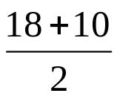
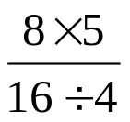
Homework: Using a Calculator (use Google calculator if you don't have one)
Use a calculator to work out the falling
a
9 – 12 ÷ 4
b
6 x 10 - 9 x 5
c
(5 x 4) + 19
d
(36 + 22) x 33
6
15
39
1914
e
f
2
10
Bags of sugar come in three different sized packets. Work out which bag is the best value for money.
Large: 454g for 87p
Medium: 400g for 80p
Small: 130g for 25p
Large:
5.22p per g
Medium:
5p per g
Small:
5.2p per g

